Slide 1
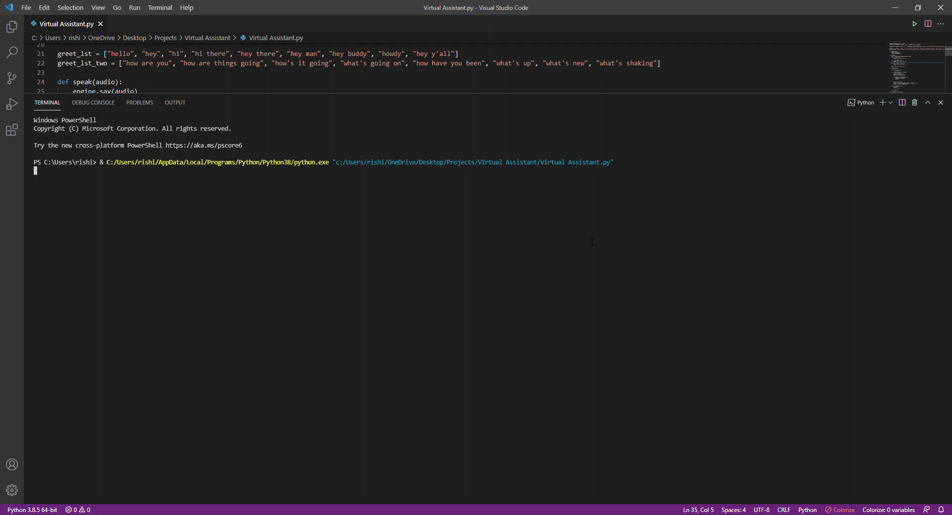
Jarvis is a virtual assistant I created who can tell you the time, date and the meaning of any word

Slide 2
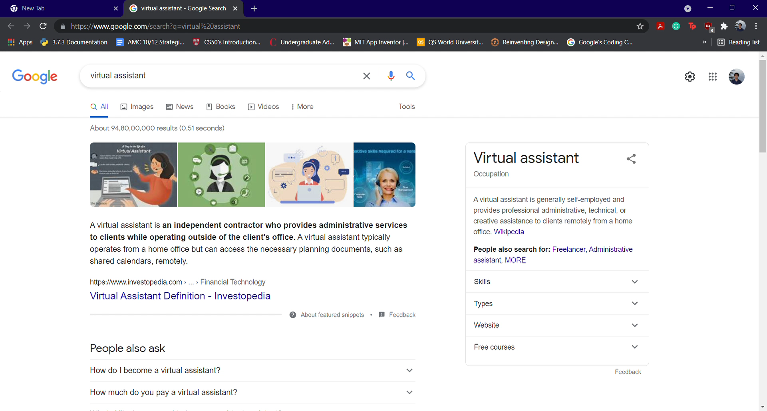
He can even search anything on Google, YouTube, Wikipedia and open any site on Google
He can even

